Slide 1
Dialog Dairies
Submitted to: Submitted by: Group Z
Graham Wall Kriti(C0776212)
Professor, Lambton College Jatin Kumar Bhola (C0778001) Emar Morrison (C0782758) Gurpreet Singh (C0784329) Gurpreet Kaur (C0780760)

Slide 2
Technology used:
Django – Django is a open source, platform independent python-based web framework which works on Model-Template-View(MTV) architecture. It is maintained by the Django Software Foundation.
SQLite – SQLite is a relational database management system contained in a C library. It is not a client–server database engine. Rather, it is embedded into the end program.

Slide 3
Features
User registration and login
Create blog post
Update blog post
Delete blog post
Read other people blog post
Image upload
Search by title
Filter by category

Slide 4
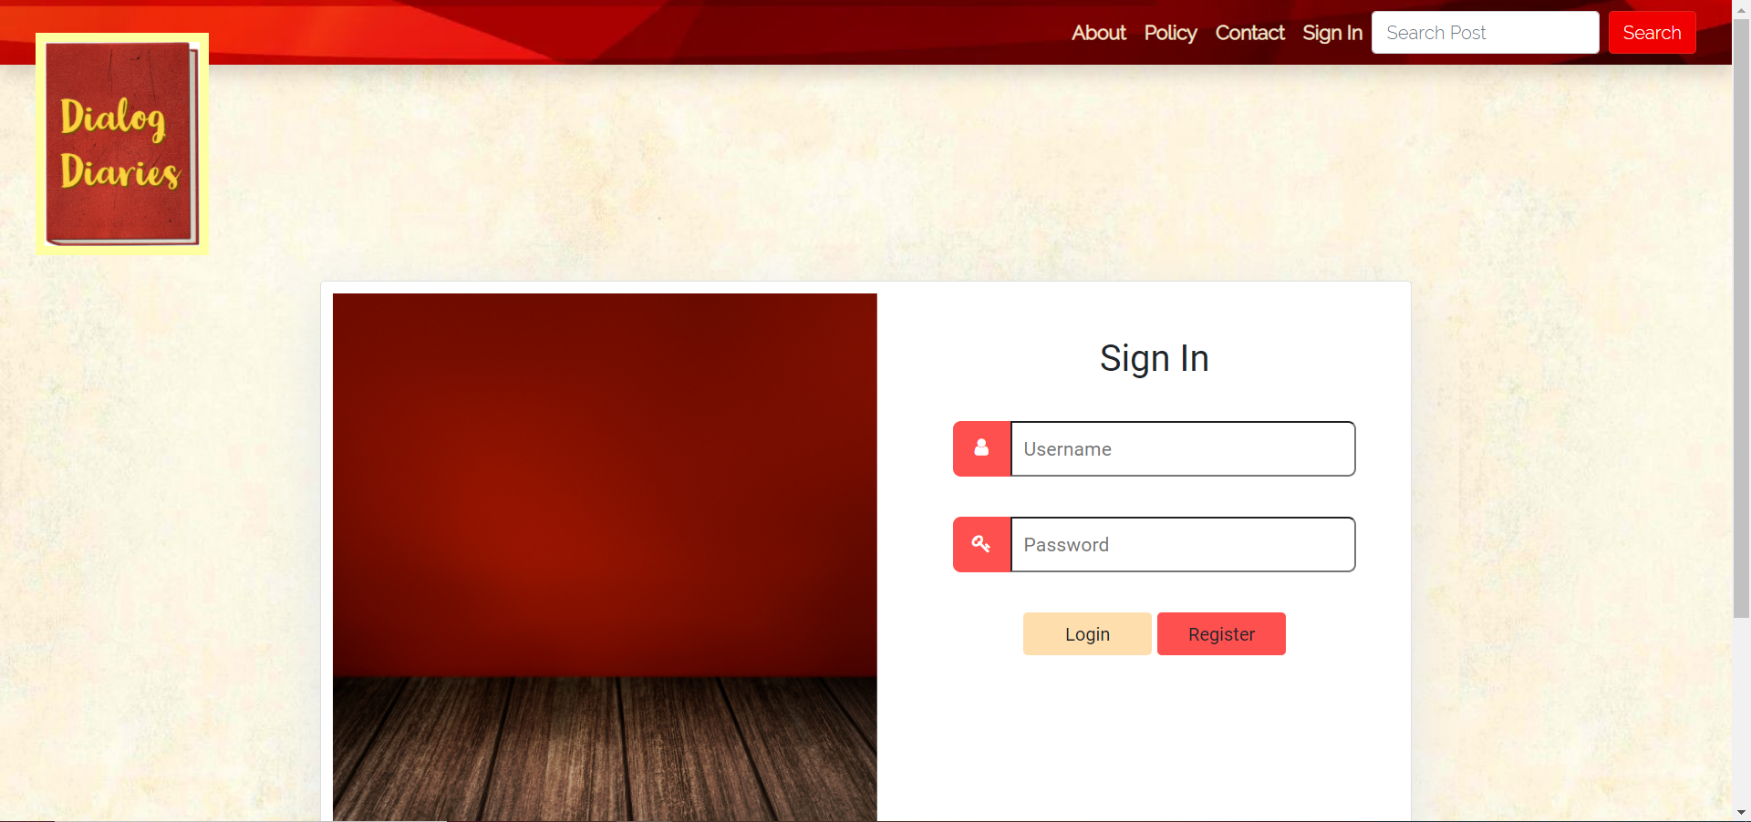
Screenshots

Slide 5
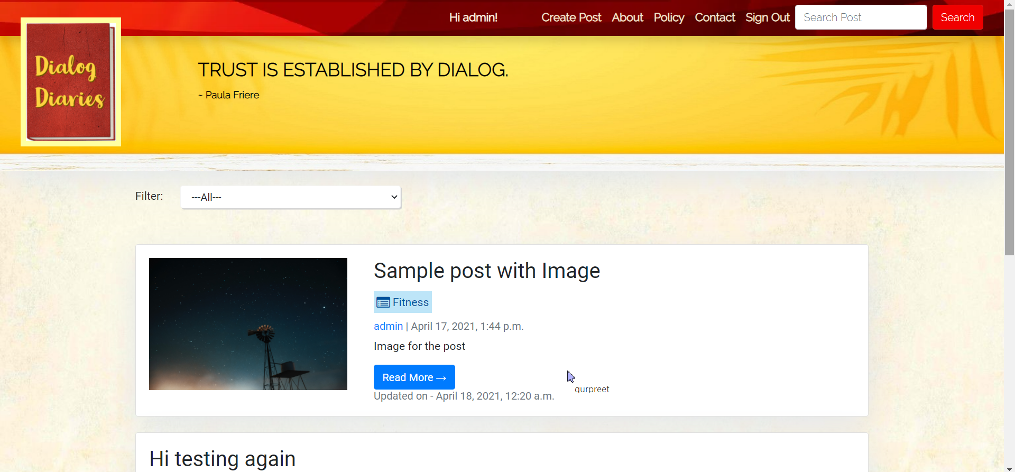
Screenshots(cont.)

Slide 6
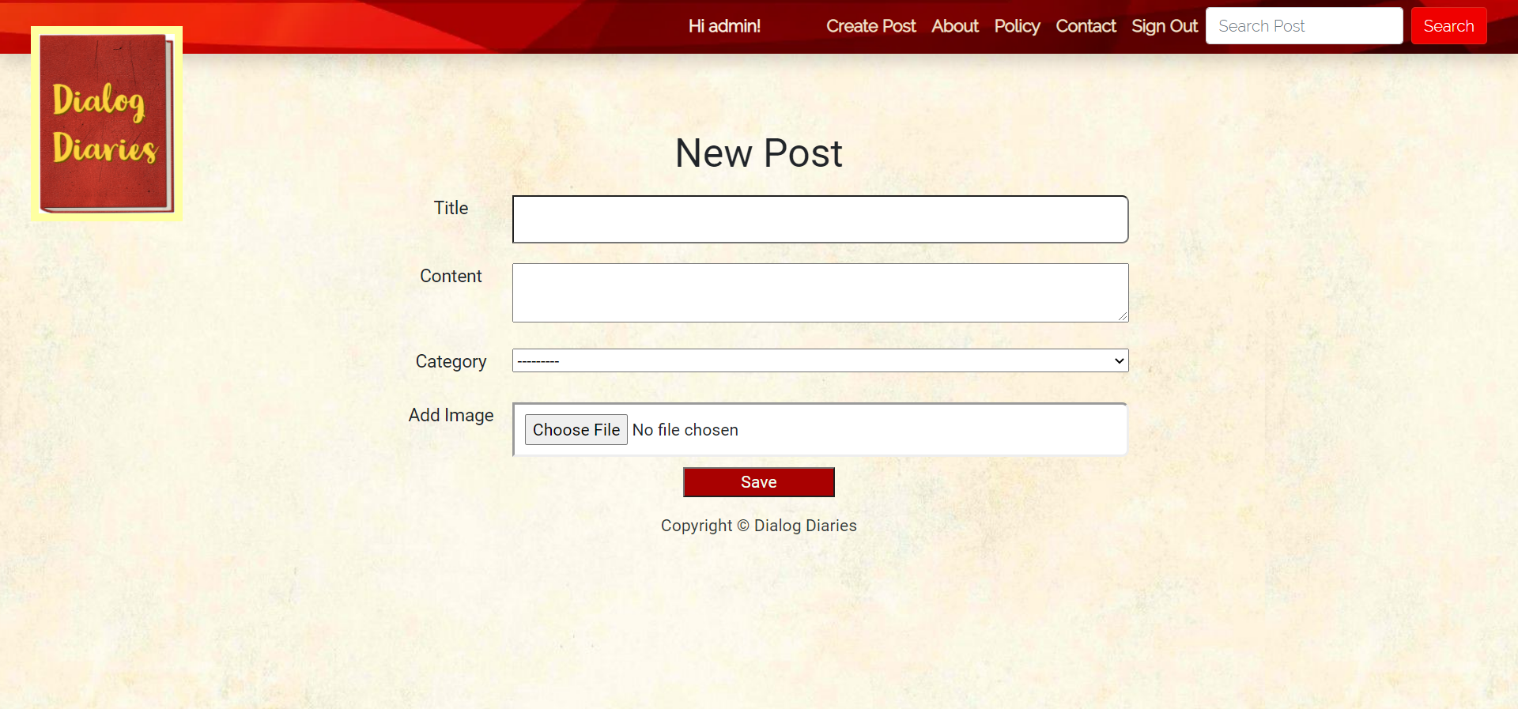
Screenshots(cont.)

Slide 7
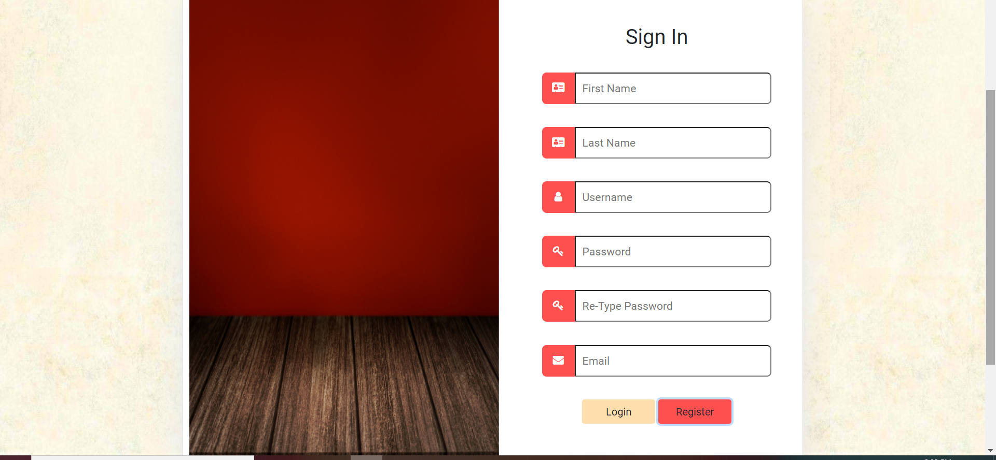
Screenshots(cont.)

Slide 8
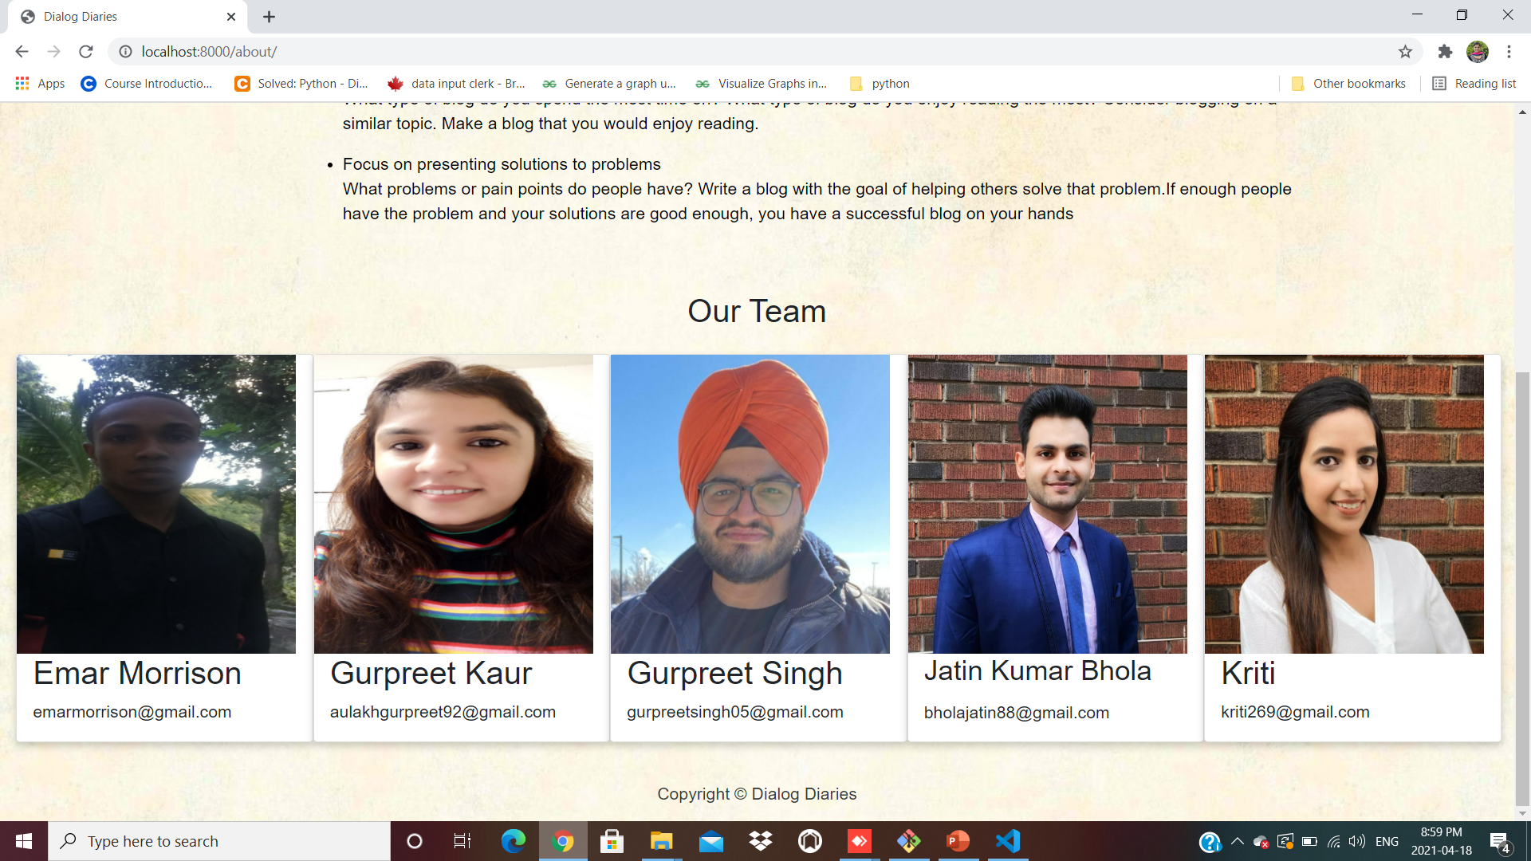
Screenshots(cont.)

Slide 9

Thank You

